Slide 1

Exodus Lesson 2

Slide 2
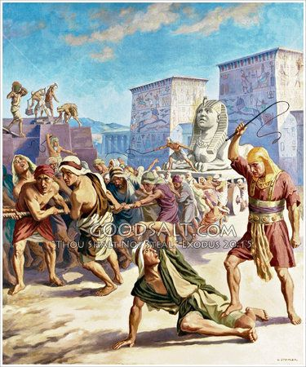

Slide 3
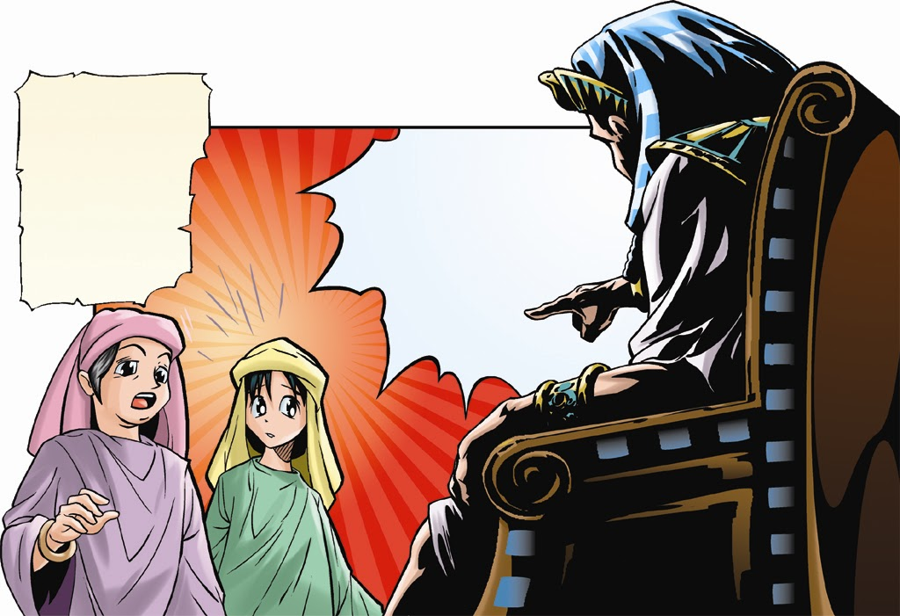

Slide 4
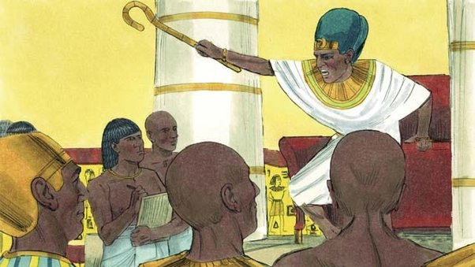

Slide 5
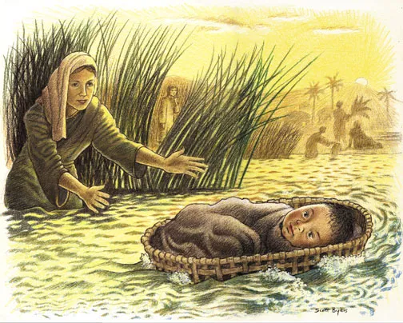

Slide 6
QUUUUUIZ!

Slide 7
What was Pharaoh’s plan to stop the Israelites?
___________
___________
___________

Slide 8
What stopped Pharaoh’s plan?
4. ___________
5. ___________
6. ___________

Slide 9
7. Who stopped Pharaoh’s plan?

Slide 10
God stopped Pharaoh’s plan!

Slide 11
Who can stop God’s plans?

Slide 12
File your quiz away

Slide 13
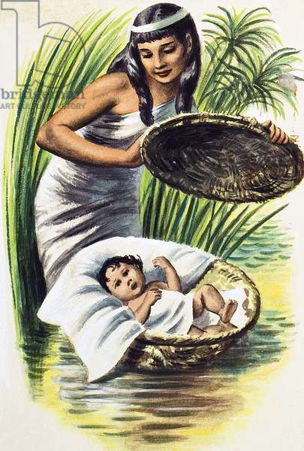

Slide 14
Exodus 2 Moses Escapes From Egypt Bible Video for Kids | Sharefaith Kids

Slide 15
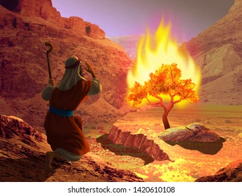

Slide 16


Yahweh is Holy
YHWH
If we could remove our sin…
We could approach God!
LOVE | BEAUTY | JOY | KINDNESS | JUSTICE | MEANING | FULL LIFE ...
Purified humans
Sinful humans
Notes:
Get hands to indicate where are you right now? The unpurified one or the purified one?

Slide 17


Yahweh is Holy
YHWH
Sinful humans
Notes:
Get hands to indicate where are you right now? The unpurified one or the purified one?

Slide 18

Puzzle Challenge

